Slide 1
Learning to Predict Layout-to-image Conditional Convolutions for Semantic Image Synthesis: Ablation Track
Computer Vision - Project Pitch
第 18 組：林學謙、林政旭、游鎮遠、謝崇志、王清翰

Slide 2
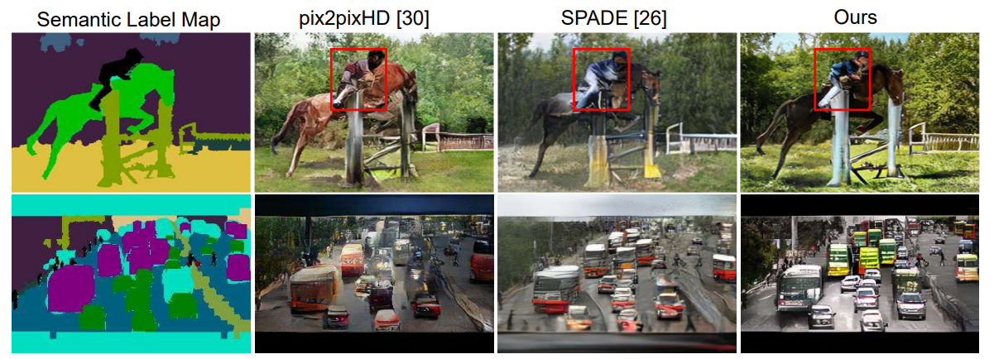
Introduction
By using GAN networks, generate the label map into a virtual picture, and try to enhance the realism of generated picture .
This Paper

Slide 3
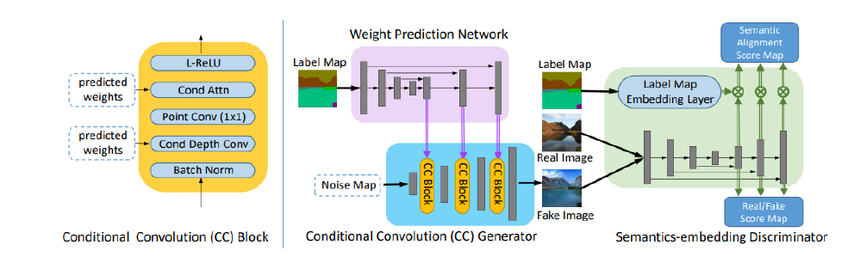
Method
Notes:
主要分成兩個部分: Conditional Convolution Generator和Semantics-embedding Discriminator。 The Conditional Convolution Generator takes a low resolution map as its input and generates a synthetic image through Conditional Convolution Blocks and the process of upsampling. The paper proposes a global-context-aware weight prediction network with a feature pyramid structure. This approach involves using varying kernel sizes and weights to preserve specific features of the label map. Furthermore, in an effort to reduce the computational demands associated with conventional convolution, it incorporates depthwise separable convolution within the CC Block, focusing exclusively on the prediction of depthwise convolutional kernel weights. This significantly reduces the number of parameters requiring prediction. A good discriminator is its capability to capture highfidelity details while maintaining semantic alignment. To achieve this, they construct multi-scale feature pyramids, which enhance high-fidelity details such as texture and edges. Furthermore, they employ a semantics-embedding discriminator to ensure spatial semantic alignment between the generated images and the input semantic layout. As illustrated in Figure 1 (right panel), they use upsampleing feature-rich maps and combine them to generate multiscale features with finer details and semantic information, thereby enforcing more robust constraints. On the other hand, to promote semantic consistency between the generated images and the label map, the paper introduces a patch-based semantics embedding discriminator. This entails computing the dot product of the label map and multi-scale feature pyramids to produce a semantic matching score map, which is then incorporated into the real/fake score, finally yielding the discriminative score. This innovative strategy serves to actualize high-detail images while ensuring semantic alignment.

Slide 4
Method
Notes:
主要分成兩個部分: Conditional Convolution Generator和Semantics-embedding Discriminator。 The Conditional Convolution Generator takes a low resolution map as its input and generates a synthetic image through Conditional Convolution Blocks and the process of upsampling. The paper proposes a global-context-aware weight prediction network with a feature pyramid structure. This approach involves using varying kernel sizes and weights to preserve specific features of the label map. Furthermore, in an effort to reduce the computational demands associated with conventional convolution, it incorporates depthwise separable convolution within the CC Block, focusing exclusively on the prediction of depthwise convolutional kernel weights. This significantly reduces the number of parameters requiring prediction. A good discriminator is its capability to capture highfidelity details while maintaining semantic alignment. To achieve this, they construct multi-scale feature pyramids, which enhance high-fidelity details such as texture and edges. Furthermore, they employ a semantics-embedding discriminator to ensure spatial semantic alignment between the generated images and the input semantic layout. As illustrated in Figure 1 (right panel), they use upsampleing feature-rich maps and combine them to generate multiscale features with finer details and semantic information, thereby enforcing more robust constraints. On the other hand, to promote semantic consistency between the generated images and the label map, the paper introduces a patch-based semantics embedding discriminator. This entails computing the dot product of the label map and multi-scale feature pyramids to produce a semantic matching score map, which is then incorporated into the real/fake score, finally yielding the discriminative score. This innovative strategy serves to actualize high-detail images while ensuring semantic alignment.

Slide 5
Method
Notes:
主要分成兩個部分: Conditional Convolution Generator和Semantics-embedding Discriminator。 The Conditional Convolution Generator takes a low resolution map as its input and generates a synthetic image through Conditional Convolution Blocks and the process of upsampling. The paper proposes a global-context-aware weight prediction network with a feature pyramid structure. This approach involves using varying kernel sizes and weights to preserve specific features of the label map. Furthermore, in an effort to reduce the computational demands associated with conventional convolution, it incorporates depthwise separable convolution within the CC Block, focusing exclusively on the prediction of depthwise convolutional kernel weights. This significantly reduces the number of parameters requiring prediction. A good discriminator is its capability to capture highfidelity details while maintaining semantic alignment. To achieve this, they construct multi-scale feature pyramids, which enhance high-fidelity details such as texture and edges. Furthermore, they employ a semantics-embedding discriminator to ensure spatial semantic alignment between the generated images and the input semantic layout. As illustrated in Figure 1 (right panel), they use upsampleing feature-rich maps and combine them to generate multiscale features with finer details and semantic information, thereby enforcing more robust constraints. On the other hand, to promote semantic consistency between the generated images and the label map, the paper introduces a patch-based semantics embedding discriminator. This entails computing the dot product of the label map and multi-scale feature pyramids to produce a semantic matching score map, which is then incorporated into the real/fake score, finally yielding the discriminative score. This innovative strategy serves to actualize high-detail images while ensuring semantic alignment.

Slide 6
Milestones
10/28: paper survey finished
10/30: project pitch ← We are here.
11/20: midterm-project due
12/8: code accomplished (include training & testing)
12/15: validation data collected
12/18 or 12/25: final project presentation
1/5: adjust project & final report finished
1/8: final project report due

Slide 7
Thanks for listening.

